Slide 1
Discrete Mathematics
BCSC0010
Module 1
Sets(Lecture 4)

Slide 2
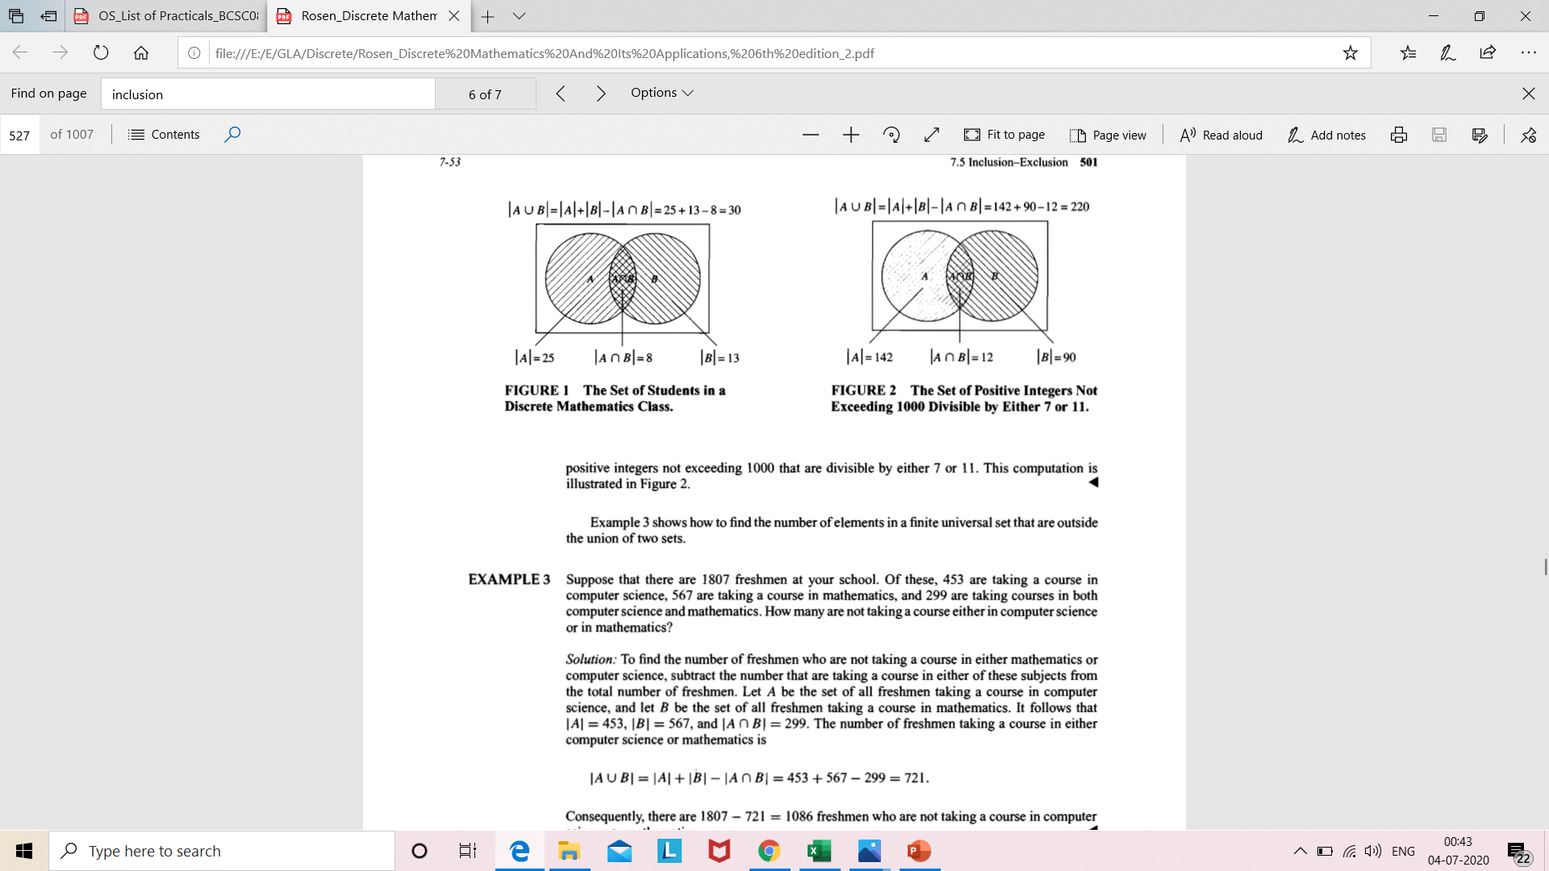
Cardinality of a Union of two finite sets A and B
|A U B| = |A| + |B| - |A ⋂ B|

Slide 3
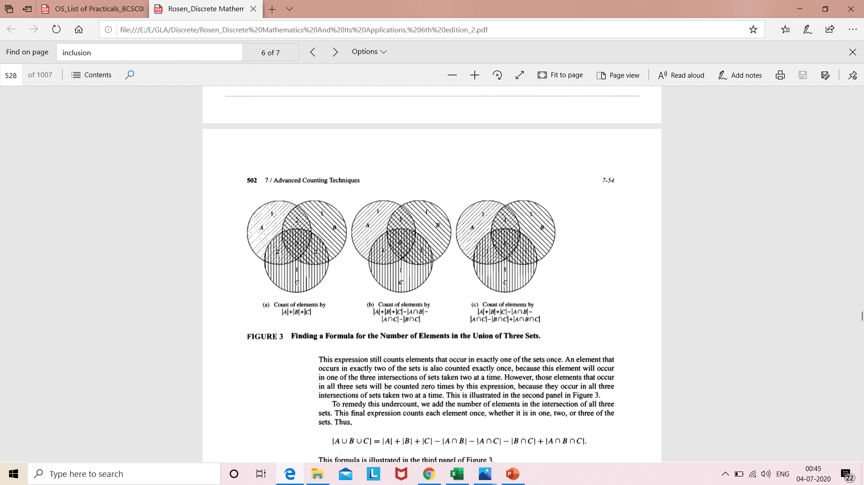
Cardinality of a Union of three finite sets A,B and C

Slide 4
Cardinality of a Union of three finite sets A,B and C

Slide 5
Cardinality of a Union of three finite sets A,B and C
∣ A ∪ B ∪ C ∣ = ∣ A ∣ + ∣ B ∣ + ∣ C ∣ − ∣ A ∩ B ∣ − ∣ A ∩ C ∣ − ∣ B ∩ C ∣ + ∣ A ∩ B ∩ C ∣

Slide 6
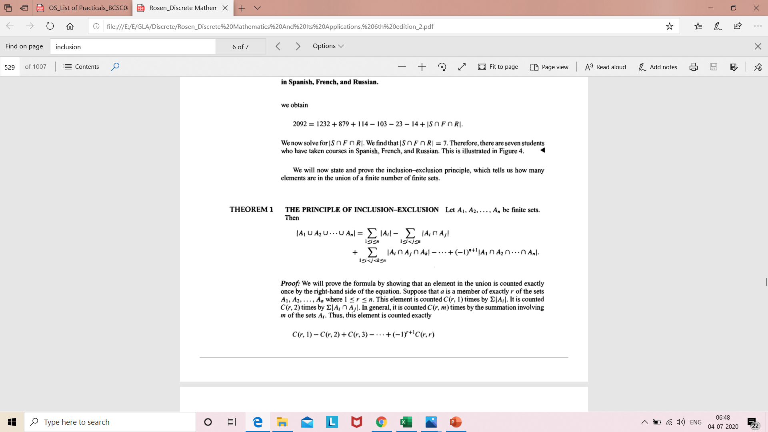
Principle of Inclusion Exclusion
For 2 sets, |A U B| = |A| + |B| - |A ⋂ B|
For 3 sets, ∣ A ∪ B ∪ C ∣ = ∣ A ∣ + ∣ B ∣ + ∣ C ∣ − ∣ A ∩ B ∣ − ∣ A ∩ C ∣ − ∣ B ∩ C ∣ + ∣ A ∩ B ∩ C ∣
For n sets,

Slide 7
Problem based on Principle of Inclusion Exclusion
|A U B| = |A| + |B| - |A ⋂ B|
Among 50 patients admitted to a hospital, 25 are diagnosed with pneumonia, 30 with bronchitis, and 10 with both pneumonia and bronchitis. Determine:
(a) The number of patients diagnosed with pneumonia or bronchitis (or both).
(b) The number of patients not diagnosed with pneumonia or bronchitis.
Solution
Let U denote the entire set of patients. Let P and B denote the set of patients diagnosed with pneumonia and bronchitis respectively. Thus:
|U| = 50, |P| = 25, |B| = 30, |P ∩ B| = 10
Contd..

Slide 8
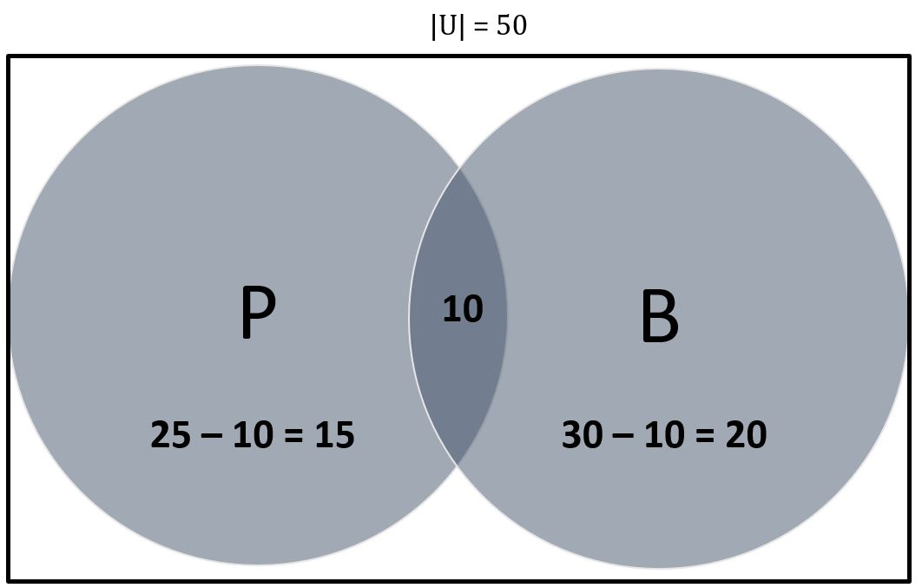
(a) By Venn Dig.,
|P ∪ B| = 15 + 10 + 20= 45
Thus 45 patients are diagnosed with pneumonia or bronchitis.
By using formula,
|P ∪ B| = |P| + |B| – |P ⋂ B|
= (25 + 30) – (10) = 45
Thus 45 patients are diagnosed with pneumonia or bronchitis.
(b) |(P ∪ B)’|
= 50 – 45 = 5
5 patients are not diagnosed with pneumonia or bronchitis.

Slide 9
Problem based on Principle of Inclusion Exclusion(for 3 sets)
∣ A ∪ B ∪ C ∣ = ∣ A ∣ + ∣ B ∣ + ∣ C ∣ − ∣ A ∩ B ∣ − ∣ A ∩ C ∣ − ∣ B ∩ C ∣ + ∣ A ∩ B ∩ C ∣
A large software development company employs 100 computer programmers. Of them, 45 are proficient in Java, 30 in C#, 20 in Python, 6 in C# and Java, 1 in Java and Python, 5 in C# and Python, and just 1 programmer is proficient in all three languages above. Determine the number of computer programmers that are not proficient in any of these three languages.
Solution
Let U denote the set of all employed computer programmers and let J, C and P denote the set of programmers proficient in Java, C# and Python, respectively. Thus:
|U| = 100, |J| = 45, |C| = 30, |P| = 20, |J ∩ C| = 6, |J ∩ P| = 1, |C ∩ P| = 5, |J ∩ C ∩ P| = 1
Contd..

Slide 10
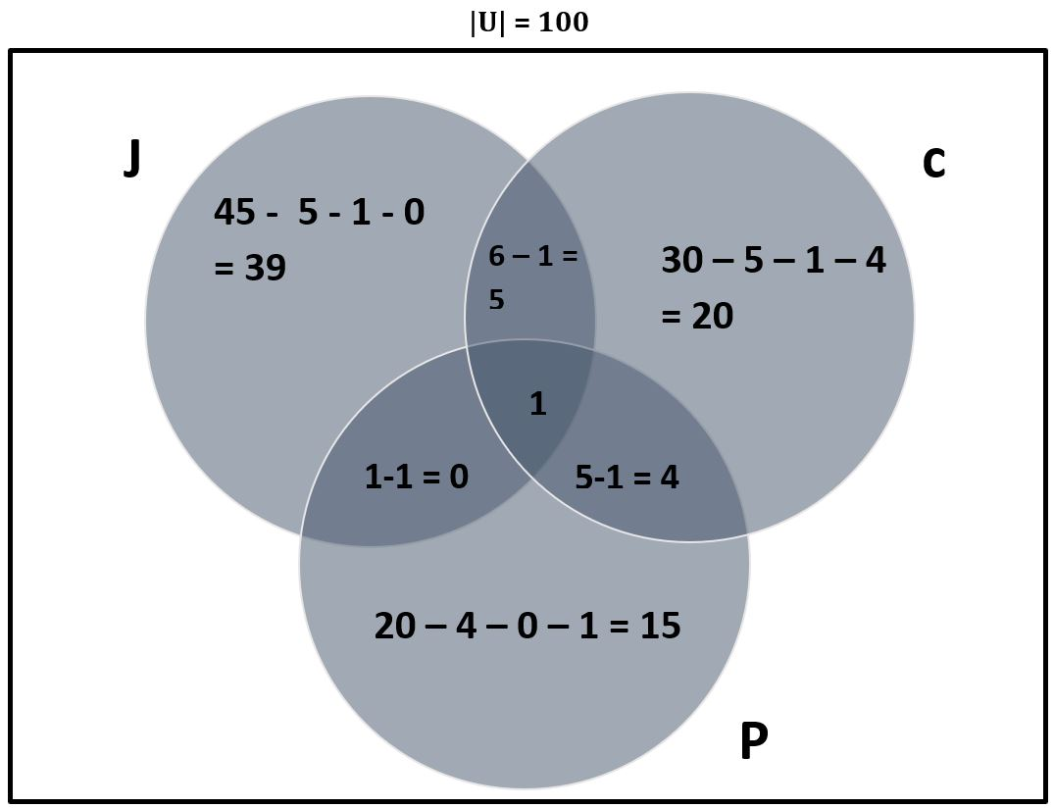
|J ∪ C ∪ P|
= 39 + 5 +20 +4 +15 + 1
= 84
Now calculate the complement:
|(J ∪ C ∪ P)’ | = |U| – |J ∪ C ∪ P|
= 100 – 84
= 16
16 programmers are not proficient in any of the three languages.

Slide 11
Give a formula for the number of elements in the union of four sets.

Slide 12
Next Topic..
Function

